Slide 1
Data Structures (Lab-7)
Complexity Analysis

Slide 2
Agenda for Today
What is Asymptotic Notations?
Code Analysis
Big-O
Omega
Theta

Slide 3
Asymptotic Notations
Asymptotic notations are mathematical tools used in computer science to describe the behavior of functions as their input size grows to infinity.
These notations help in analyzing the time and space complexity of algorithms without getting into precise details.
The most commonly used asymptotic notations are Big O, Omega, and Theta.

Slide 4
Asymptotic Notations
Big-O Notation (O-notation) Worst case
Omega Notation (Ω-notation) Best case
Theta Notation (Θ-notation) Average case

Slide 5
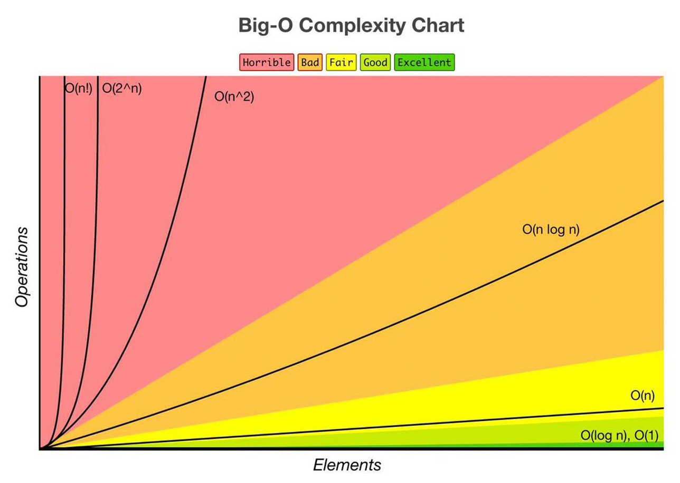
Big-O complexity chart
Big-O Chart: http://treeindev.net/article/algorithm-complexity-analysis

Slide 6
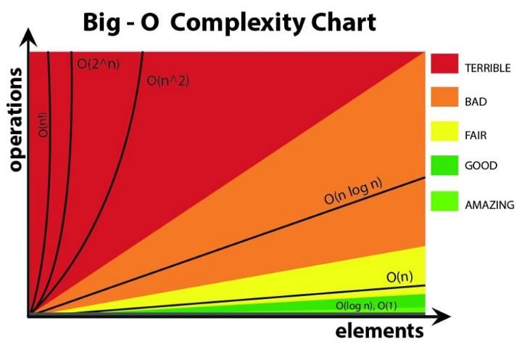
Growth orders
O(1) — constant time
O(log n) — logarithmic
O(n) — linear time
O(n²) — quadratic
O(2^n) — exponential
O(n!) — factorial

Slide 7
Example 1

